Slide 1

SwaraJ Wattamwar
Jensen Huang
150096724157
Notes:
1

Slide 2



Difference Between JPG and JPEG
Welcome to our presentation on the difference between JPG and JPEG image formats. We'll explore their characteristics, uses, and when to choose one over the other.
by Swaraj Wattamwar (BTech CSE 2024-28)
Notes:
2

Slide 3
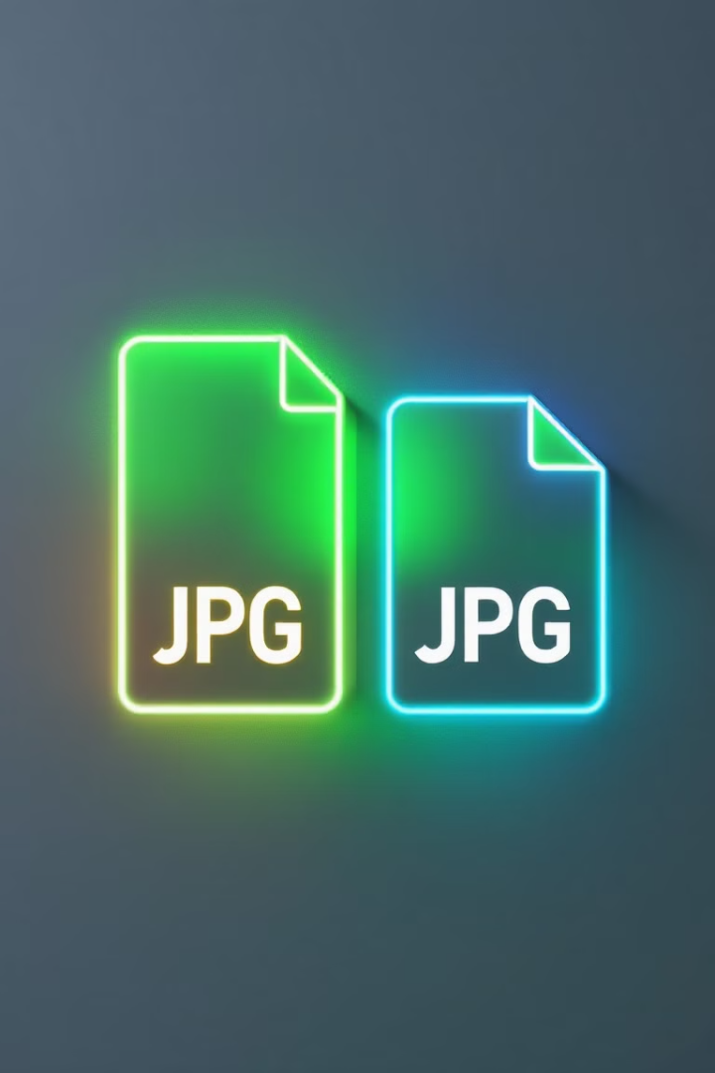
What are JPG and JPEG?
Same Format
Naming Convention
JPG and JPEG are actually the same image format.
The difference lies in the file extension naming convention.
Historical Reason
Early Windows versions limited extensions to three characters, hence "JPG".
Notes:
3

Slide 4
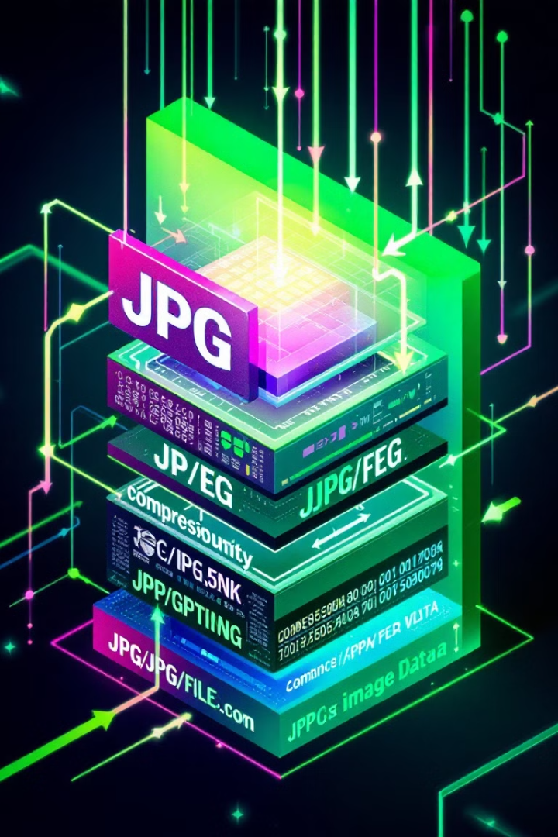



File Format Basics
Lossy Compression
JPG/JPEG uses lossy compression to reduce file size.
Photographic Images
Ideal for photographs and complex images with gradients.
Adjustable Quality
Allows balance between image quality and file size.
Notes:
4

Slide 5
Image Quality and File Size
High Quality
Low Quality
Larger file size, better image quality, minimal compression artifacts.
Smaller file size, reduced image quality, visible compression artifacts.
Notes:
5

Slide 6
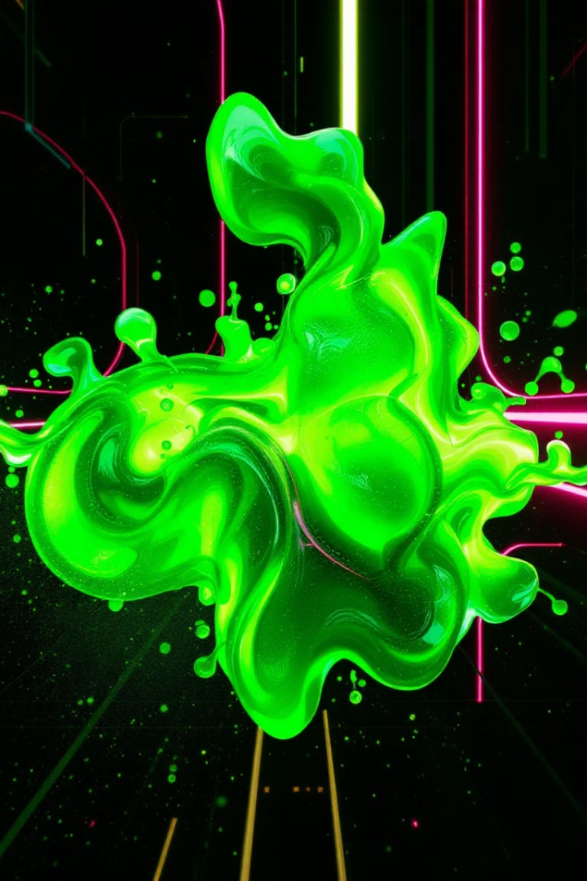
Compression Techniques
Discrete Cosine Transform (DCT)
1
Converts image data into frequency components.
Quantization
2
Reduces precision of frequency components to achieve compression.
Entropy Coding
3
Further compresses data using Huffman coding.
Notes:
6

Slide 7
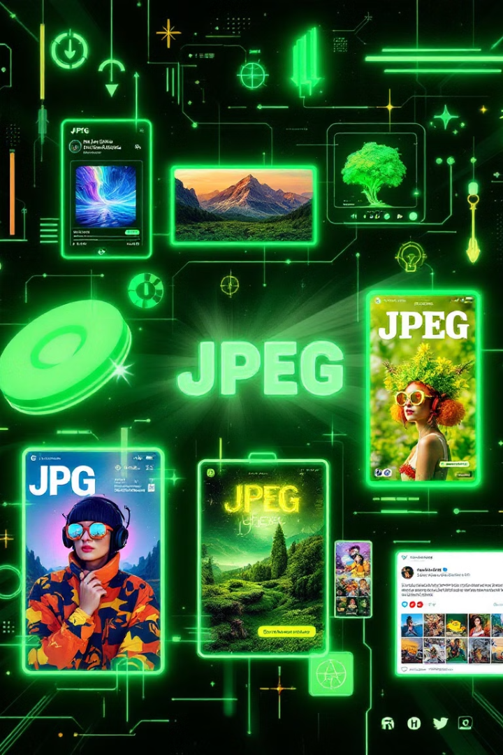
Use Cases for JPG and JPEG
Web Graphics
Digital Photography
Ideal for photographs and complex images on websites.
Standard format for storing and sharing digital photos.
Print Media
Social Media
Commonly used in magazines, brochures, and other print materials.
Preferred format for uploading images to most social platforms.
Notes:
7

Slide 8
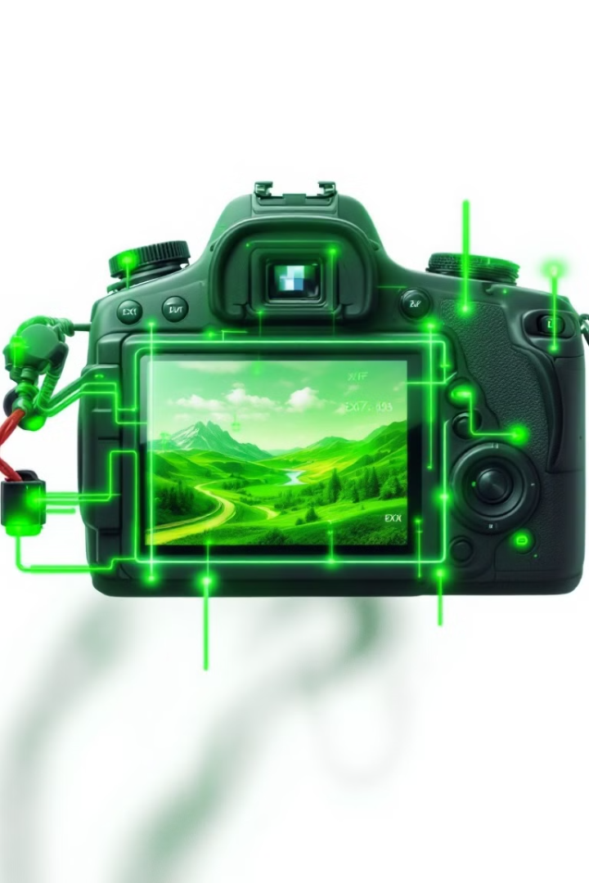



Metadata and EXIF Information
EXIF Data
Stores camera settings, date, time, and location information.
Metadata Editing
Can be modified using various software tools.
Privacy Concerns
Important to consider when sharing images online.
Notes:
8

Slide 9



Color Depth and Image Quality
24-bit Color
1
Standard JPG/JPEG color depth.
2
16.7 Million Colors
Represents a wide range of hues.
3
8 Bits per Channel
Red, Green, and Blue channels.
Notes:
9

Slide 10
File Extensions and Compatibility
1
.jpg
Most common extension, widely supported.
2
.jpeg
Fully compatible with .jpg, used interchangeably.
3
.jpe
Less common, but still recognized by many programs.
Notes:
10

Slide 11
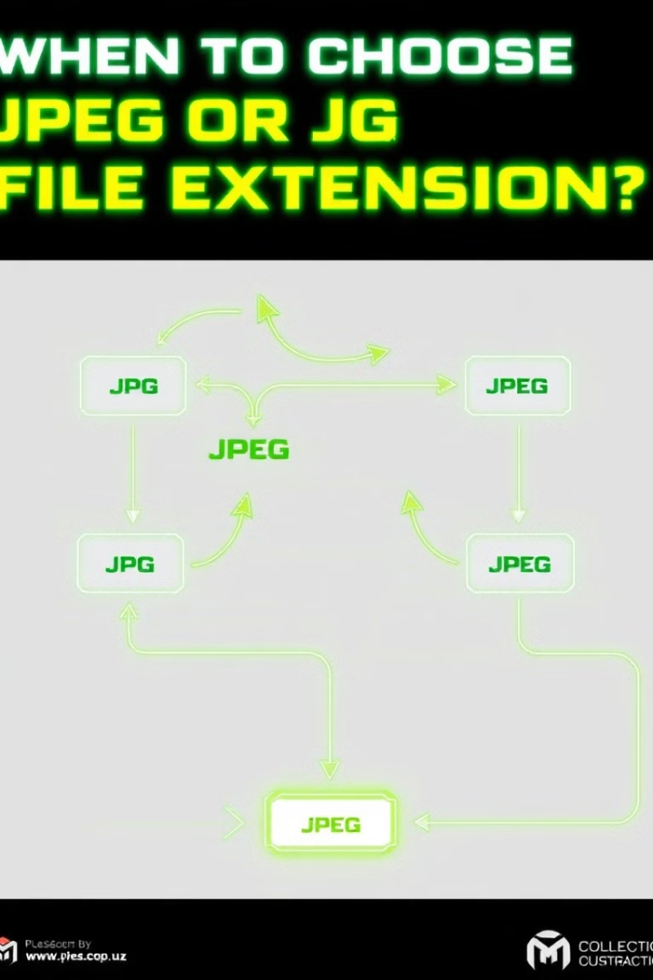
When to Use JPG vs. JPEG
100%
Compatibility
Both are equally compatible across devices and platforms.
3
Character Limit
Use JPG for systems with 3-character extension limits.
4
Standard Practice
JPEG is often preferred in professional settings.
Notes:
11

Slide 12

Notes:
12

